Slide 1
ROCK PAPER SCISSORS !!!
C++ PROJECT

Slide 2
ROCK PAPER SCISSORS !!!
AS AN ORIGINAL GAME

Slide 3
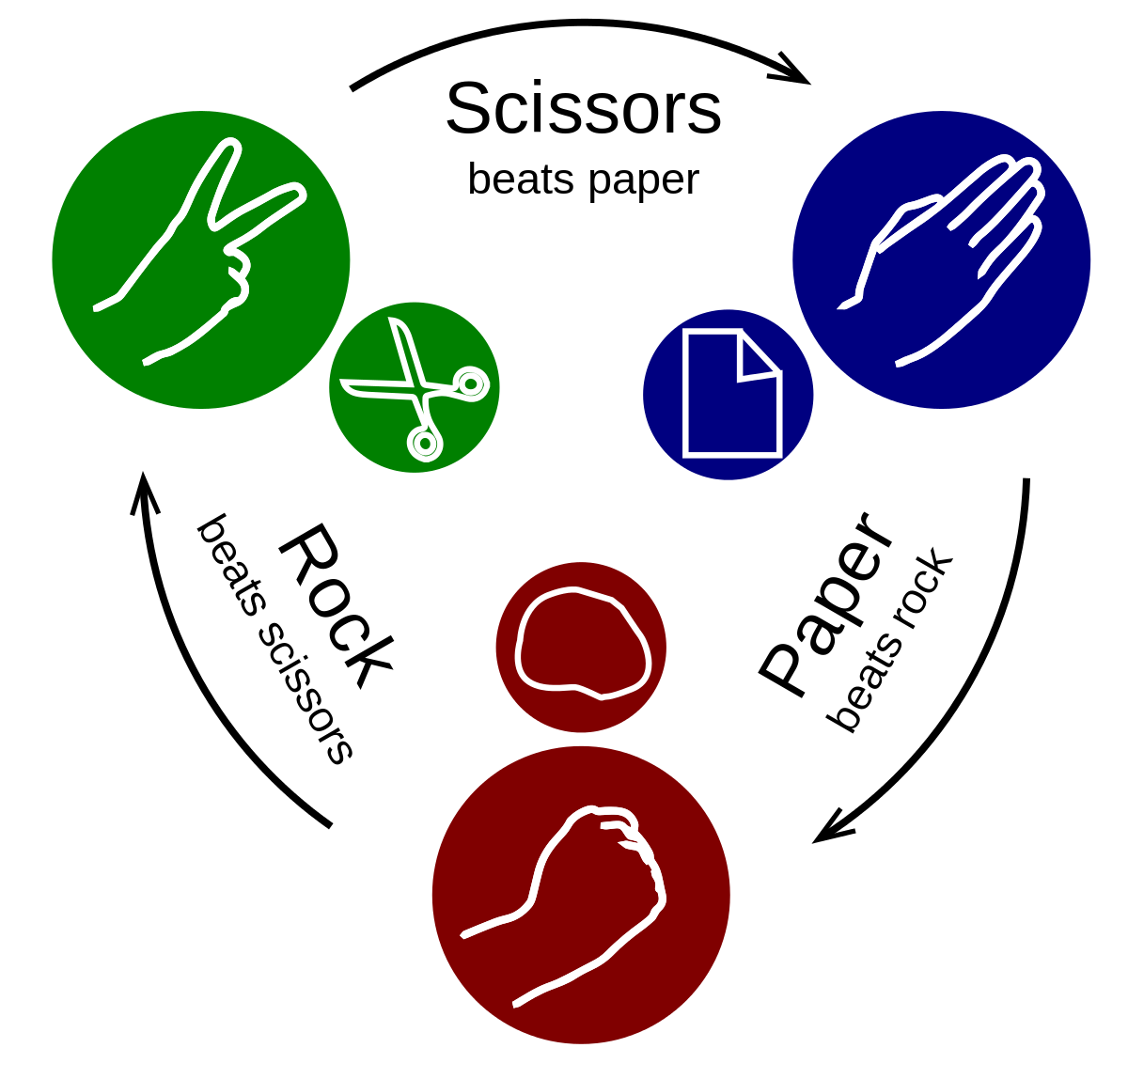
Rock paper scissors (also known as scissors rock paper, paper rock scissors and scissors paper stone) is a hand game usually played between two people, in which each player simultaneously forms one of three shapes with an outstretched hand. These shapes are "rock" (a closed fist), "paper" (a flat hand), and "scissors" (a fist with the index finger and middle finger extended, forming a V). "Scissors" is identical to the two-fingered V sign (also indicating "victory" or "peace") except that it is pointed horizontally instead of being held upright in the air. A simultaneous, zero-sum game, it has only two possible outcomes: a draw, or a win for one player and a loss for the other.
This Photo by Unknown Author is licensed under CC BY-SA

Slide 4
ROCK PAPER SCISSORS !!!
AS AN C++ PROJECT

Slide 5
EXPLANATION OF SOME INPORTANT PART OF CODE
CODE
EXPLANATION
#include <iostream>
#include <cstdlib>
#include <ctime>
using namespace std;
Inclusion of iostream, cstdlib(standard library of C language) and ctime library.
And use of standard namespace.

Slide 6
EXPLANATION OF SOME IMPORTANT PART OF CODE
int main()
{ int a,b;
while(1)
{ cout << "\n";
cout << "********** LET'S PLAY STONE,PAPER,SCISSOR **********\n";
cout <<"\n";
cout << "Please press one of the key of which discription is given below\n";
cout << "Press '0' if you want to choose paper\n";
cout << "Press '1' if you want to choose rock\n";
cout << "Press '2' if you want to choose scissors\n";
cout << "Press '3' if you want to exit \n";
cin >> a;
cout << "\n";
cout << "rock ! paper ! scissors !.......\n";
Declaration of two int variables a and b.
0=Paper
1=Rock
2=Scissors
3=EXIT
Your choice is saved in a.

Slide 7
EXPLANATION OF SOME IMPORTANT PART OF CODE
b = rand()%3;
switch (b)
{case 0:
{cout << "##### PAPER #####\n";
break;}
case 1:
{cout << "##### ROCK #####\n";
break;}
case 2:
{cout << "##### SCISSORS #####\n";
break;}
}
rand() function is used in C to generate random numbers.
b stores the computer’s choice.
Display of what is computer’s choice using switch -case.
And similarly we have displayed what the player have chosen in another set of switch case conditions.

Slide 8
EXPLANATION OF SOME IMPORTANT PART OF CODE
if (a == 0 && b == 1)
{
cout << "*******USER WINS********\n";}
else if(a == 0 && b == 0)
{
cout << "*******DRAWS*******\n";
}
else if(a == 0 && b ==2)
{
cout << "*******COMPUTER WINS*******\n";
}
With the help of nested if else we compared computer’s choice with the user’s and then result is displayed.

Slide 9
PROJECT BY:- 1)HIMANSHU RATHEE-CO19327 2)ANKIT GUPTA-CO19311 3)SHASHANK BANSAL-CO19358

Slide 10
THANK YOU

